Slide 1

HW1 Stack Invader
Data Structures EECS2040

Slide 2

Brief
Data Structures EECS2040 - Homework 1

Slide 3
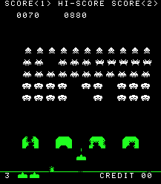
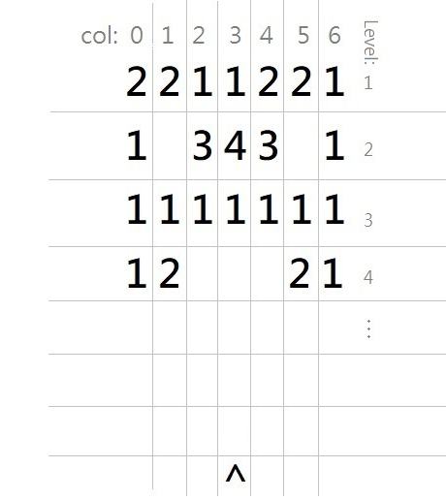
First impression
Inspired by the classic arcade game Space Invader
Simplified rules and the mechanics
Can be solved with C/C++ basic, queues, stacks.
Data Structures EECS2040 - Homework 1
Notes:
We changed the representation of enemy from image to number. The number means the type of an enemy.
詳細會在稍後說明

Slide 4
Goal
Building wheels
Queue
Stack
Implement the game core
Monitoring enemy positions
Player commands (firing bullets & querying enemy positions)
Data Structures EECS2040 - Homework 1

Slide 5
Details
Data Structures EECS2040 - Homework 1

Slide 6
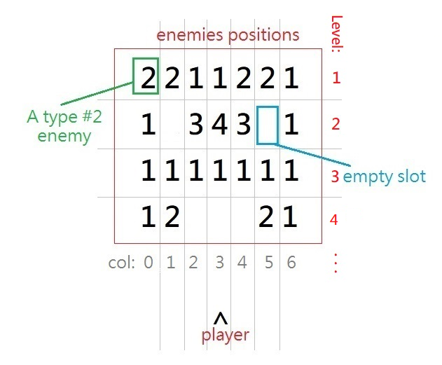
Stage
Enemies are placed in a grid.
The numbers represent the enemy types. (1 to 5)
Enemy positions and types will be specified in the input
Player fires from the bottom
Columns index starts from 0
Levels index starts from 1
Data Structures EECS2040 - Homework 1
Notes:
For this problem, you will deal with a stage that the enemy positions and their type are pre-defined.
Difference between enemies will be explained later

Slide 7
Bullet types
Normal Bullets
Shotgun Shells, noted as <SG>
Penetration bullets, noted as <P>
Super Bullets, noted as <SB>
These are referred as special bullets
The special bullets need to earned and will be fired in the order as they are collected.
Data Structures EECS2040 - Homework 1

Slide 8
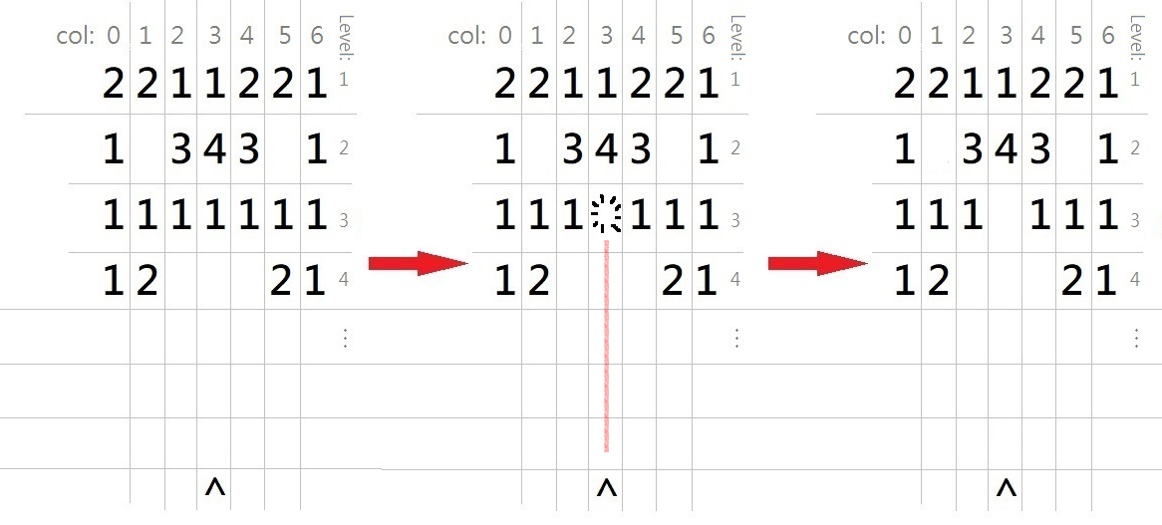
Bullet types - Normal bullets
Kills one enemy at a time
No special effects.
Infinite ammo
Data Structures EECS2040 - Homework 1

Slide 9
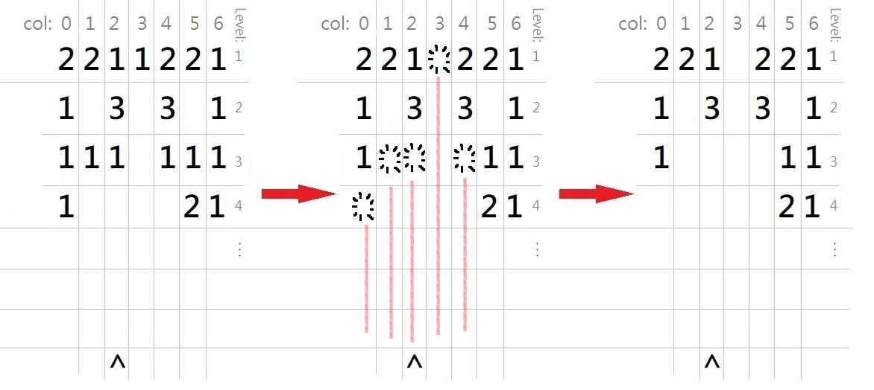
Bullet types - Shotgun Shells <SG>
Kills 5 enemies at a time
Equals shooting 5 normal bullets to 5 different columns.
(Aiming at col. X, will end up hitting the col. X-2 ~ X+2)
Data Structures EECS2040 - Homework 1

Slide 10
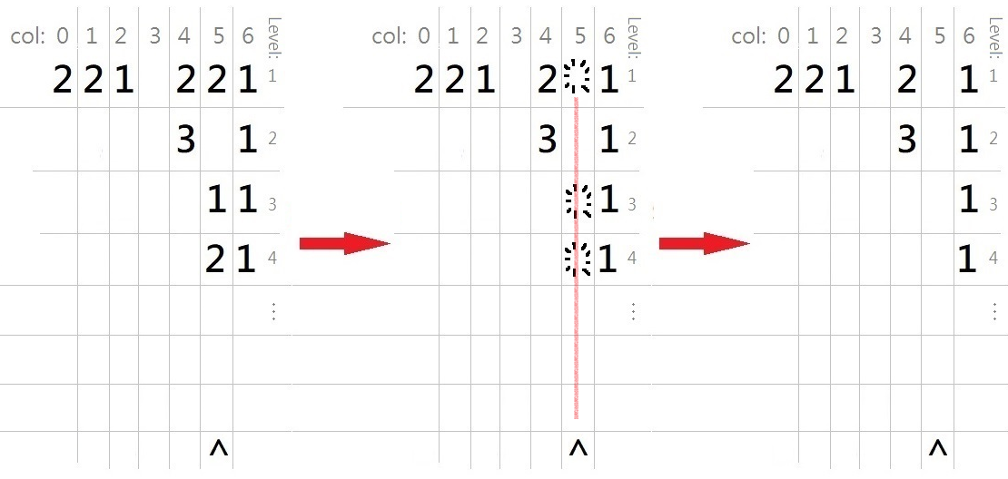
Bullet types - Penetration bullets <P>
Kills 3 enemies in the same column at a time.
Equals shooting 3 normal bullets to 1 column.
Data Structures EECS2040 - Homework 1

Slide 11
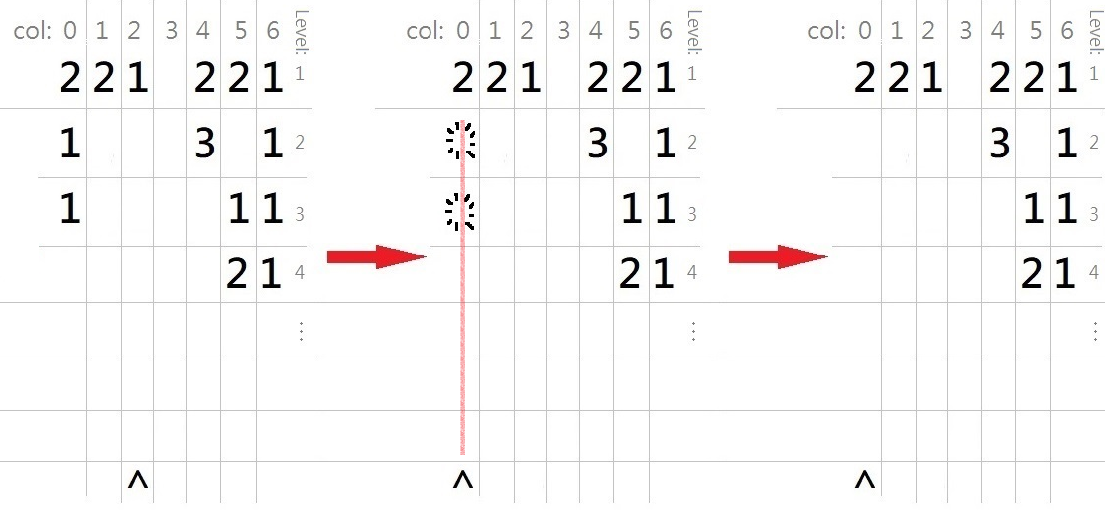
Bullet types - Super bullets <SB>
Kills the same type of enemy in a column as many as possible…
until it meets a different kind of enemy.
Data Structures EECS2040 - Homework 1

Slide 12
Enemies
There are 5 types of enemies:
Enemy #1 : A Normal enemy. Nothing special.
Enemy #2 : If a player kills it, the player gets a shotgun shell <SG>.
Enemy #3 : If a player kills it, the player gets a penetration bullet <P>.
Enemy #4 : If a player kills it, the player gets a super bullet <SB>.
Enemy #5 : If a player kills it in col. X, for each col. X-2 ~ X+2 will generate 3 new enemies If the max level that contains any enemy of those columns is L, the enemies will be placed at level L+1, L+2, L+3.
Data Structures EECS2040 - Homework 1

Slide 13
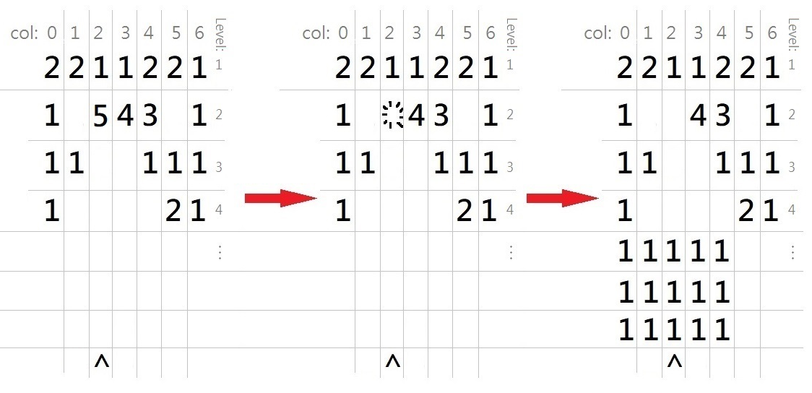
Example of Enemy #5
LEVEL: 4
COL:
X-2 ~ X+2
Data Structures EECS2040 - Homework 1

Slide 14
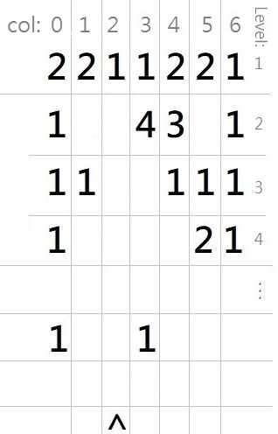
Player commands
SHOOT <col> : Fire a normal bullet at a column.
E.g., “SHOOT 3” means firing a normal bullet at column 3.
SPECIAL <col> : Fire a special bullet at a column.
E.g., “SPECIAL 3” means firing a special bullet at column 3.
FRONT_ROW : Query the max level that contains any enemy and show the enemies on that level.
Output will be like: FRONT_ROW, LEVEL: 6
1 _ _ 1 _ _ _
LEVEL: 6
Data Structures EECS2040 - Homework 1

Slide 15
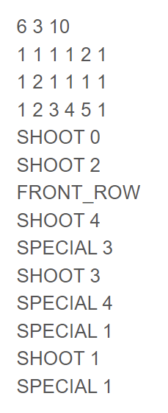
INPUT
Including…
The initial state parameter (# of columns and rows)
the number of commands.
Enemy types and positions.
Player commands.
Data Structures EECS2040 - Homework 1

Slide 16
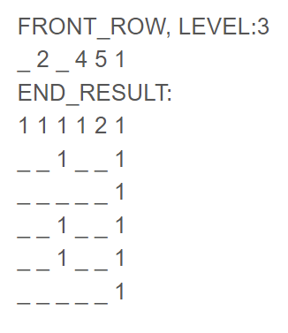
OUTPUT
Print the front row information if player use the command “FRONT_ROW”
After all the commands are finished, print the remaining enemies’ info.
Data Structures EECS2040 - Homework 1

Slide 17
How to Start
Data Structures EECS2040 - Homework 1

Slide 18
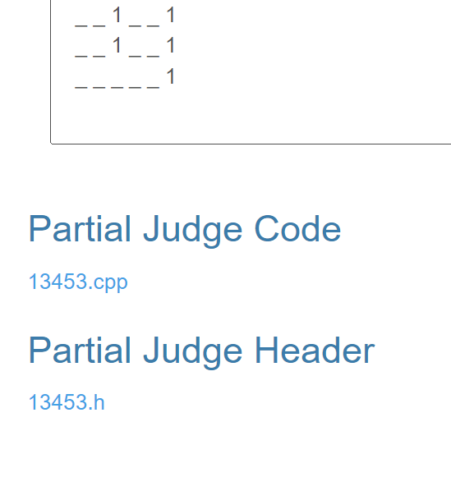
How to start (Using IDE Code::blocks)
This is a partial judge problem. You need to compile two .cpp files and a header file together.
Download the two files at the bottom of the problem page.
https://acm.cs.nthu.edu.tw/contest/2491/#problem13453
Rename the .h file to “function.h”
Data Structures EECS2040 - Homework 1

Slide 19
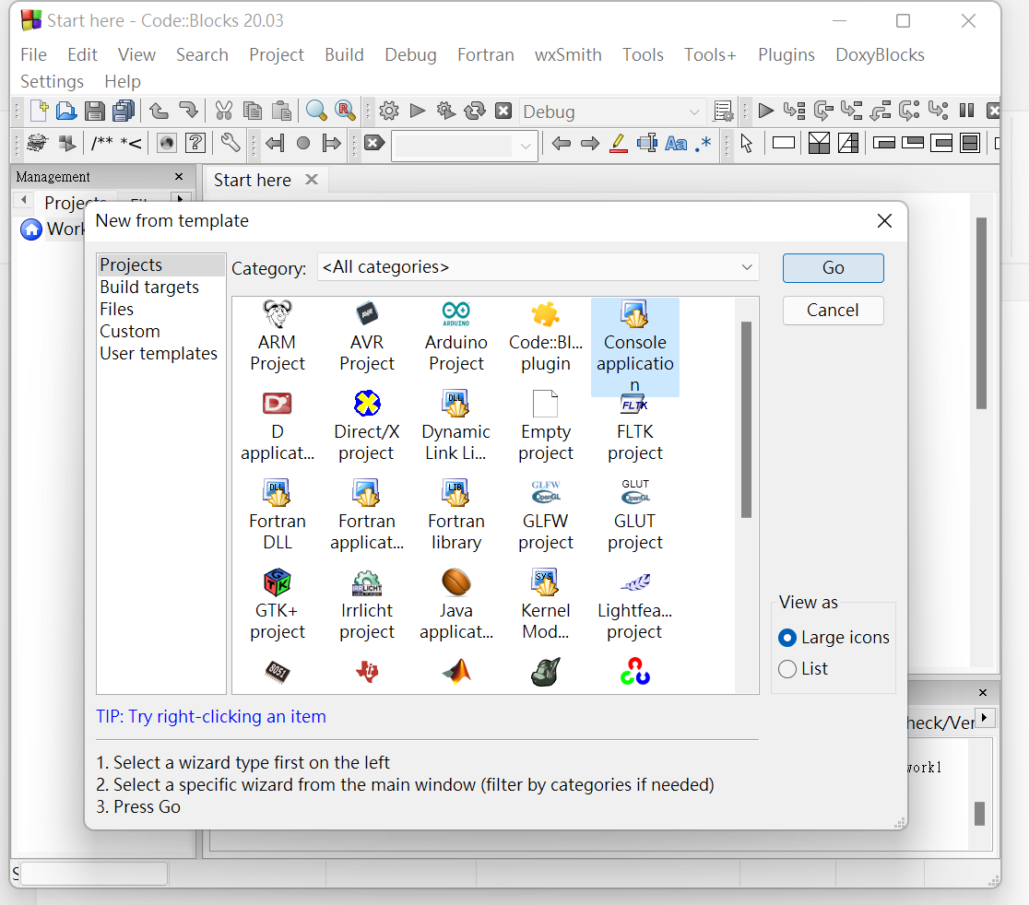
How to start (Using IDE Code::blocks)
Create a new console application project in code::blocks.
Data Structures EECS2040 - Homework 1

Slide 20
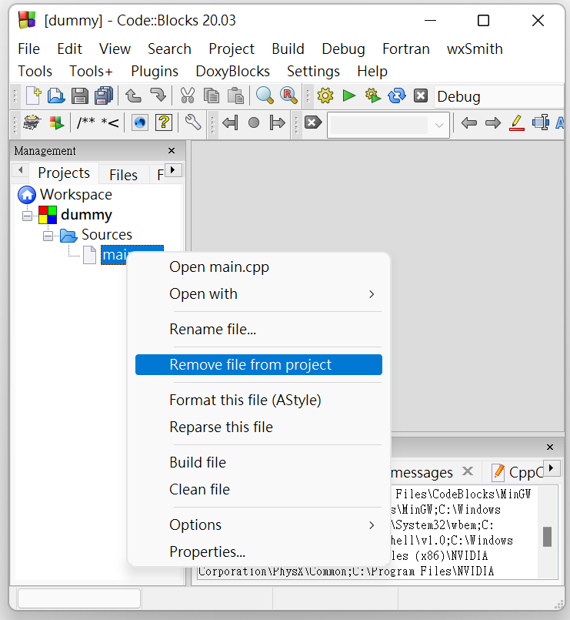
How to start (Using IDE Code::blocks)
Remove the original main.cpp file.
Data Structures EECS2040 - Homework 1

Slide 21
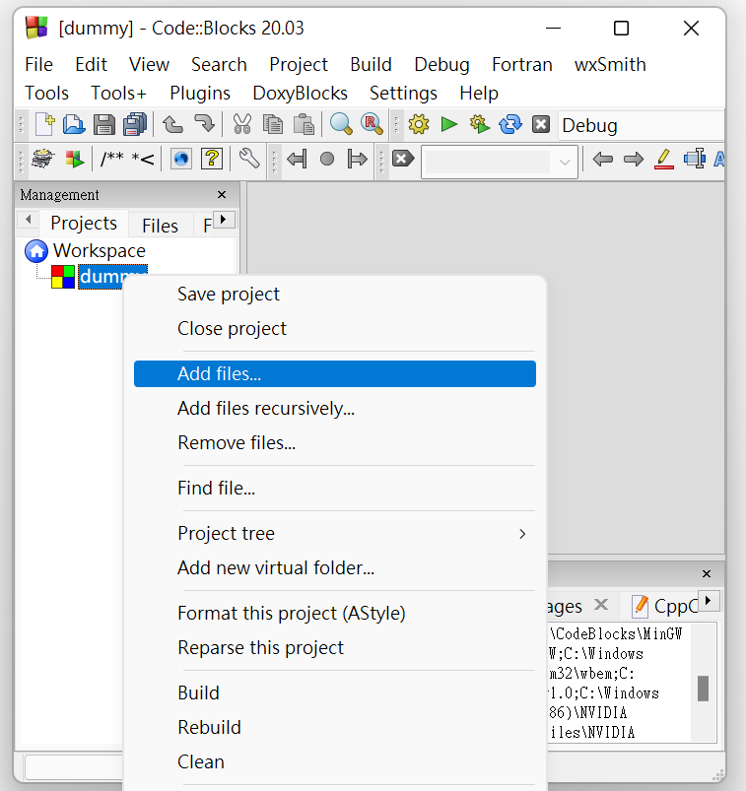
How to start (Using IDE Code::blocks)
Create a file “function.cpp”
Add the 2 files you downloaded and the “function.cpp” file you just created into the project.
Start writing your code but remember to write only in the “function.cpp” file.
Data Structures EECS2040 - Homework 1

Slide 22
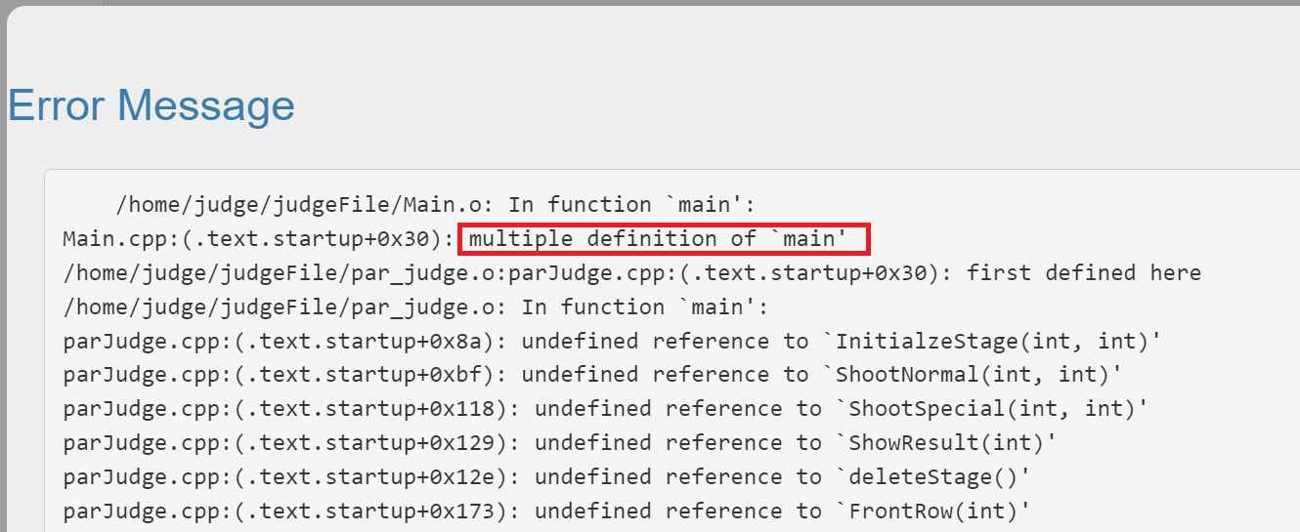
How to start (Using IDE Code::blocks)
You only need to submit your function.cpp code to OJ. (No need to upload the two files we provided)
Otherwise, you might get a compile error since the two files we provided are already uploaded in the OJ.
Data Structures EECS2040 - Homework 1

Slide 23
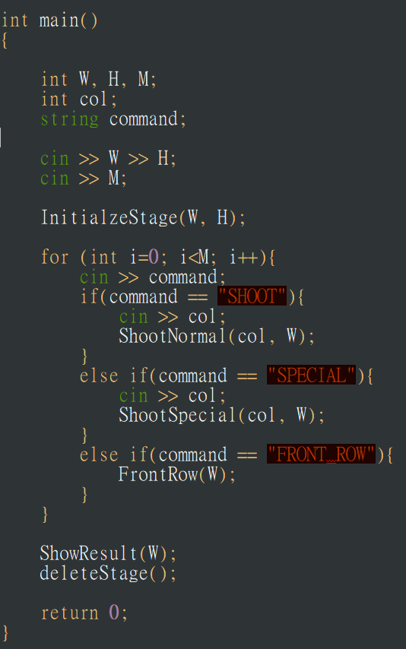
Understand the code
13453.cpp : Like an interaction interface
It reads some of the inputs.
It calls some functions specified in the header file with inputs as parameters.
Data Structures EECS2040 - Homework 1

Slide 24
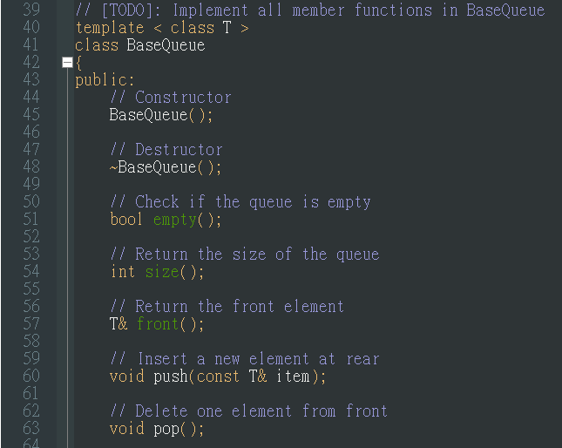
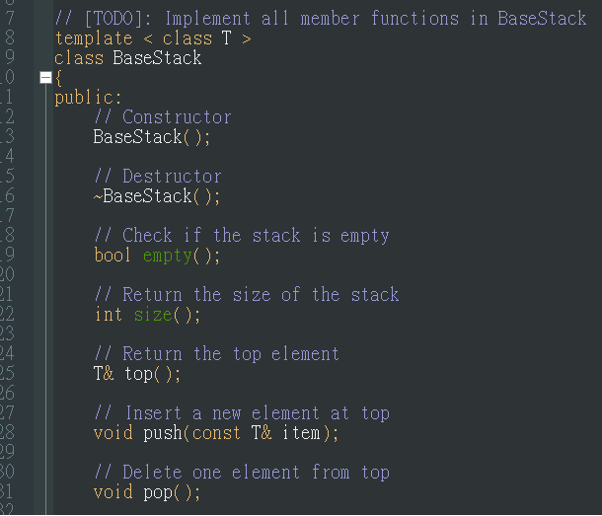
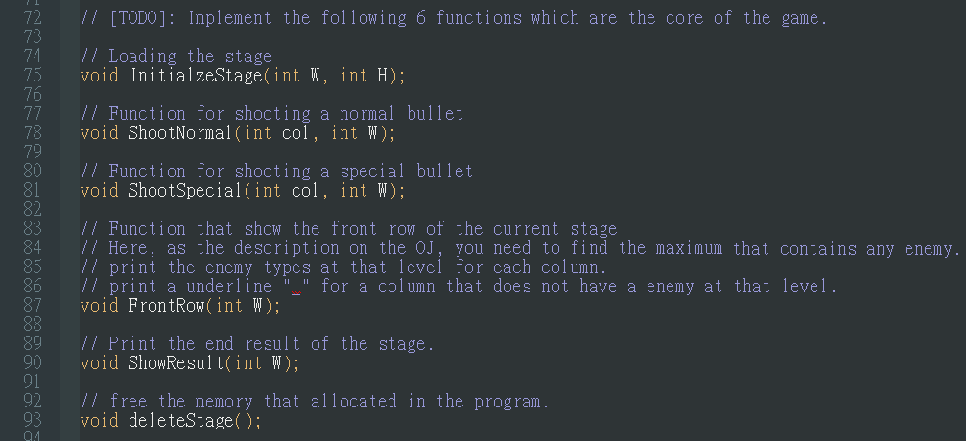
Understand the code
13453.h : [TODO] Tags tell you the underlying functions to implement in your own function.cpp file.
Data Structures EECS2040 - Homework 1

Slide 25
Hint
Think about the characteristics of the queues and stacks.
Choose a more suitable data structure for implementing enemy position and special bullets shooting orders depends on their characteristics.
Data Structures EECS2040 - Homework 1

Slide 26
Hint
Conquer the problems one by one: (sample workflow)
Make sure that your Stack and Queue work properly.
Load the enemies’ position & types.
Implement the function ShowResult(int W).
Handling shooting normal bullets.
Handling enemy effects.
Handling special bullets effects.
Handling front row queries.
Be careful about those empty slots. You might need to check them many times in an operation, depends on your design.
Data Structures EECS2040 - Homework 1

Slide 27
Hint
You are allowed to write addition functions and declare global variables if that helps you implementing the system or debugging.
Data Structures EECS2040 - Homework 1

Slide 28
Hint
You could refer the related resource provided on the course website if you got stuck. http://www.cs.nthu.edu.tw/~yishin/courses/EECS2040/EECS2040-2022.html
Resource for C++ template syntax : https://vinesmsuic.github.io/2020/01/12/c++-template/#class-templates (Chinese) https://www.codeproject.com/Articles/257589/An-Idiots-Guide-to-Cplusplus-Templates-Part-1 (English)
Data Structures EECS2040 - Homework 1

Slide 29
Summary
Deadline: 03/27 23:59
Quiz related to this homework will be held on 03/28 18:30.
Feel free to ask questions to our TAs if you don’t understand some part of the homework or have some trouble when doing the homework. But since we have limited time, we won’t help you debugging.
No plagiarism is allowed!
Data Structures EECS2040 - Homework 1

Slide 30
Good Luck!
Data Structures EECS2040 - Homework 1

